Slide 1
Payment Innovation (with a Pacific Lense)
Craig Kirkland, Director Pacific Islands

Slide 2
Our Focus on the Pacific
Financial Inclusion
People
SMEs
Indigenous banks
Digitisation
Expanding acceptance
SME
eCommerce
Transit
Tourism
“doing well by doing good”
“Development delayed is development denied”

Slide 3
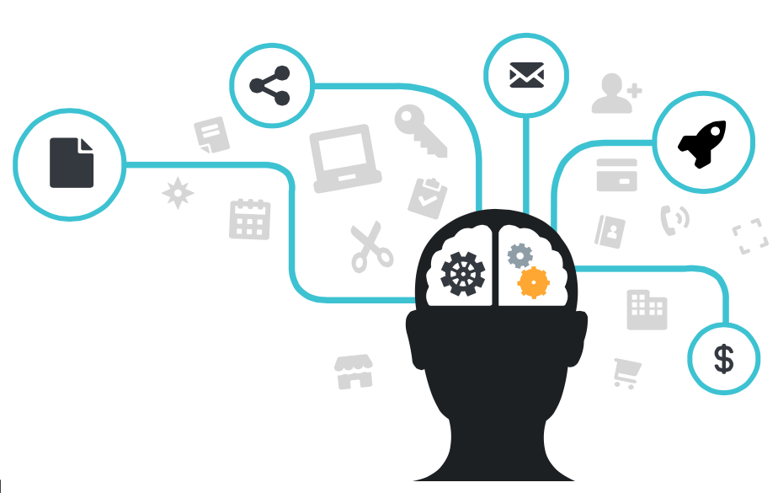
Innovation
Solving existing problems in a new way, particularly if the innovation enhances peoples’ lives.
Leveraging or enhancing platforms
Leveraging existing platforms
Digital
People centric!

Slide 4
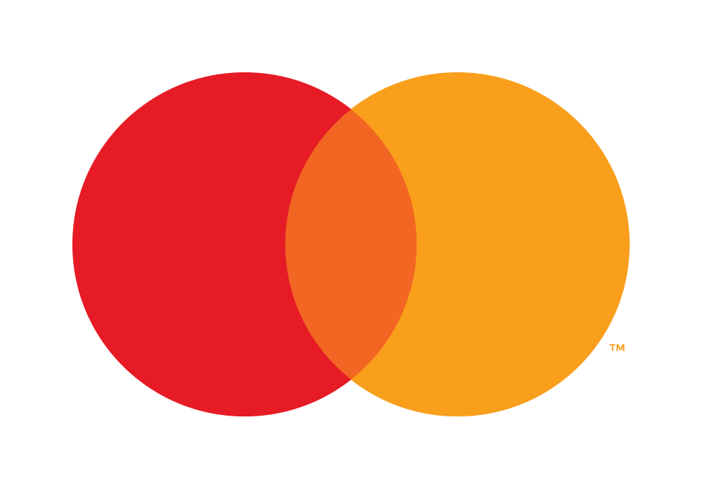
“Cash prevalence” increases the risk of…
The ubiquity of cash, its universal acceptance and its convenience in handling low-value purchases, justify its continued existence.
Although contactless card or e-wallet payments are growing as a result of being able to mimic cash in terms of consumer behaviour, they cannot replace the tangibility of cash.
Nonetheless, the widespread use of cash does come with costs.
01
Inefficient financial system with high cost of cash
02
Shadow economy, with missed tax revenues
03
Financial exclusion
04
Hindered economic growth
05
Crime and corruption
©2023 Mastercard. Proprietary and confidential
4
4
Notes:
Speaker: Lucas
Well the truth is, cash continues to be extremely resilient. Its universal acceptance, its convenience in handling low-value purchases and innate anonymity continue to justify its existence. It’s evident that even with the growth of payment technologies such as e-wallets and contactless cards have still been unable to completely displace the tangibility of cash. The prevalence of cash however does come with many risks.
These include but are not limited to:
Firstly, Inefficient financial systems – where the management of cash is extremely time consuming, with all parties in the payment system bearing costs across the value chain
A shadow or 'informal' economy, with missed tax revenues from unreported income due to businesses and individuals engaging in inappropriate practices
Financial exclusion - cash economies results in merchants and consumers have reduced access to common financial services and education that will better serve their needs to achieving a better quality of life.
Hindered economic growth - Reduced accessibility to payment acceptance methods reduces the ability for consumers and businesses to connect worldwide
And last but not least, crime and corruption. Cash will always be a physical asset subject to theft which continues to be a threat to this day.

Slide 5
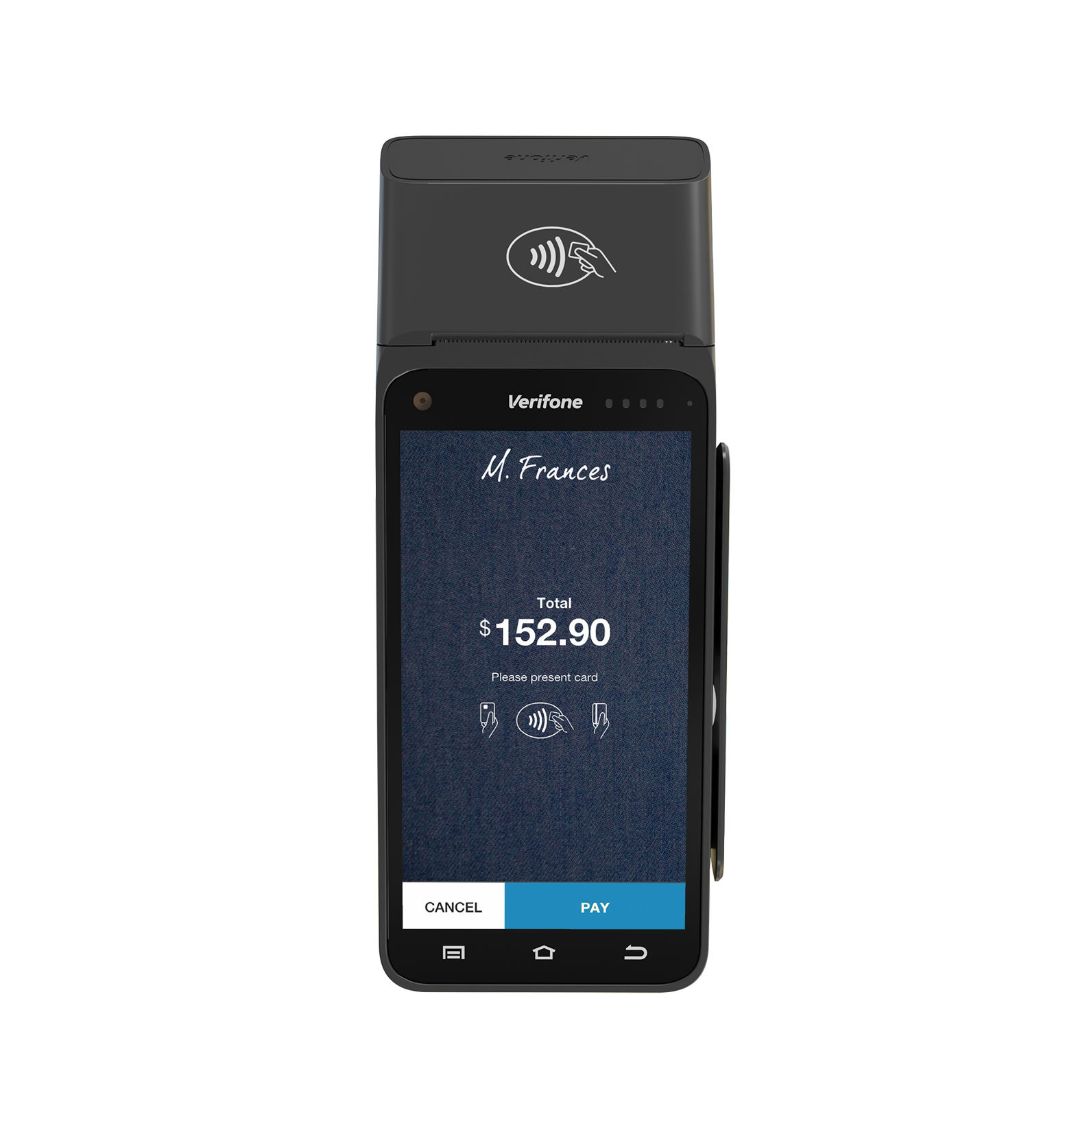
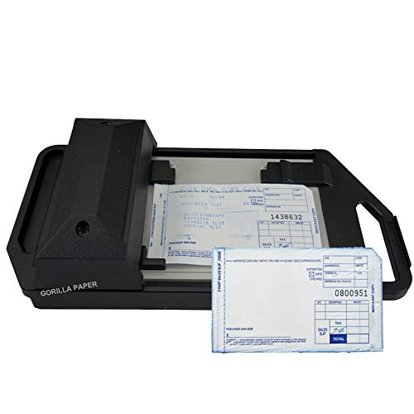
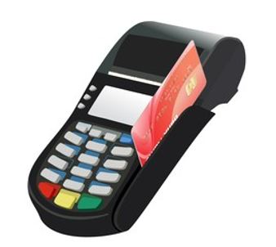
A little bit on the history of innovation

Slide 6
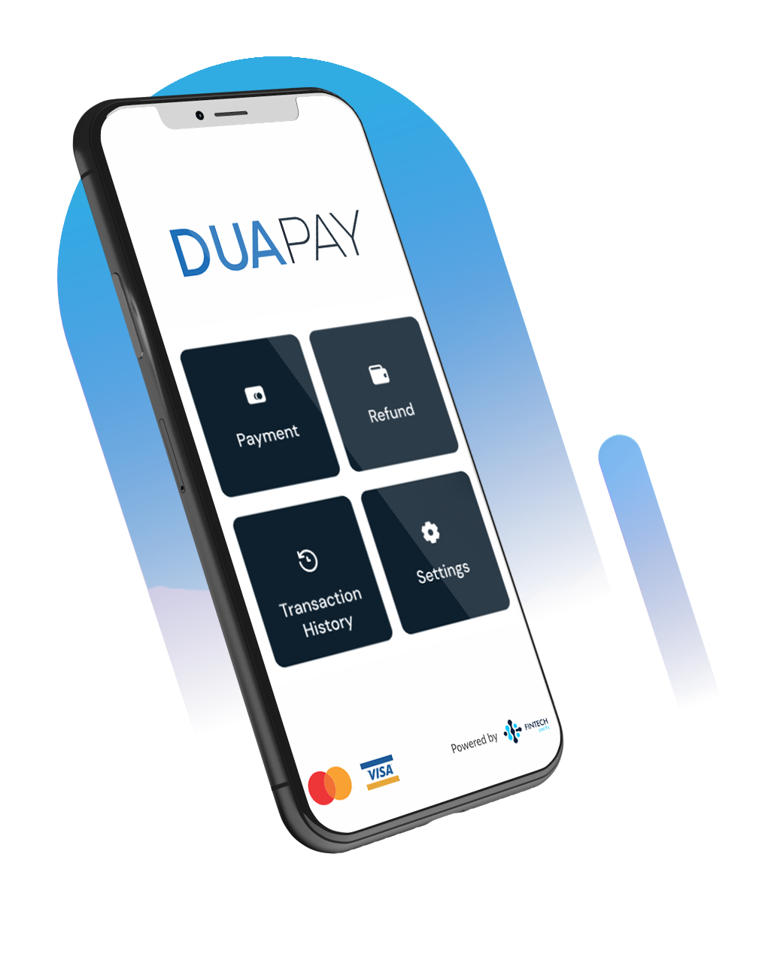
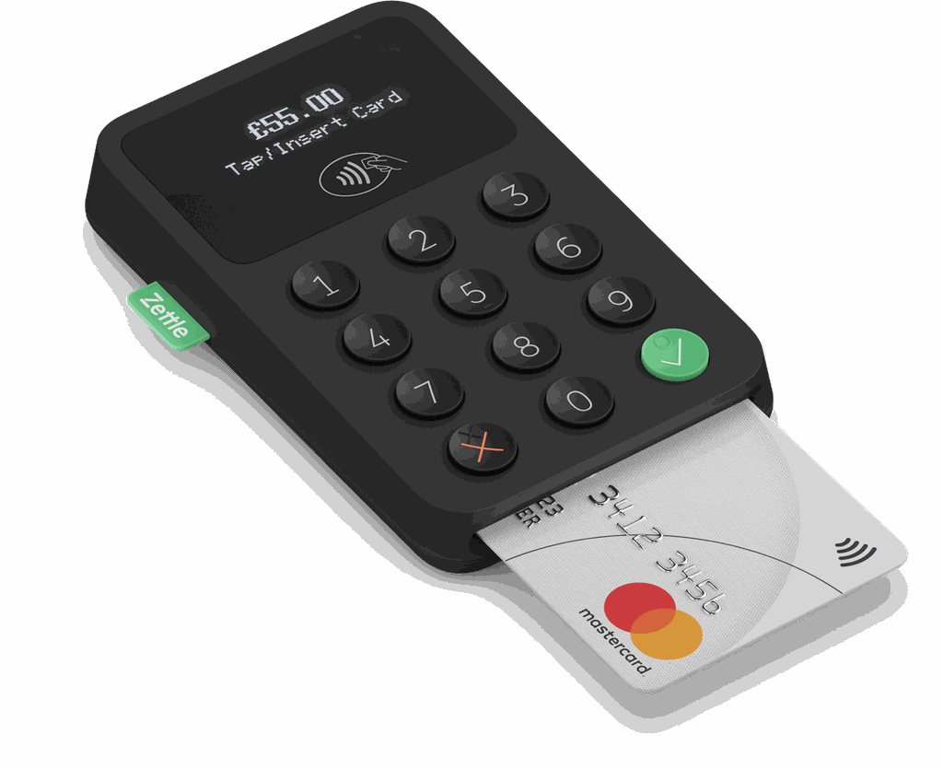
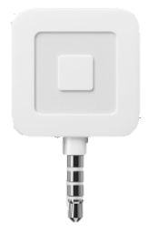
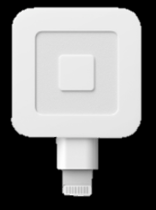
A little bit on the history of innovation

Slide 7
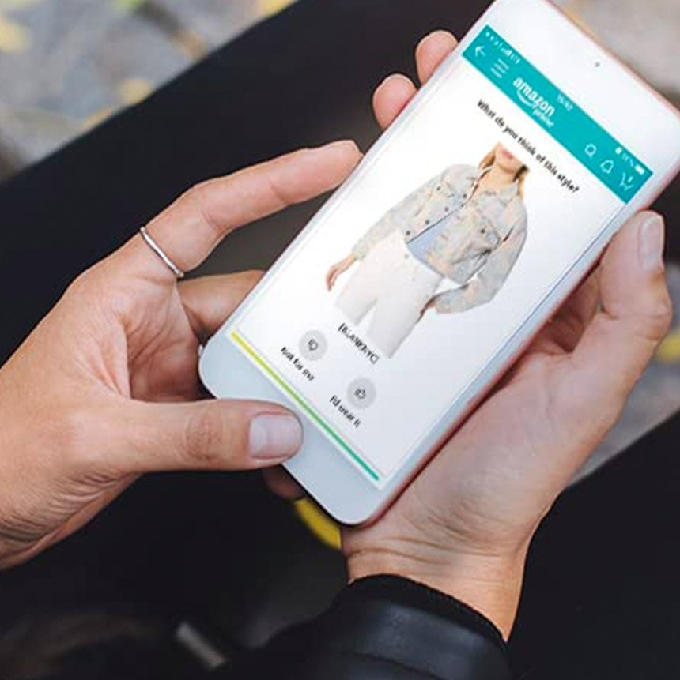
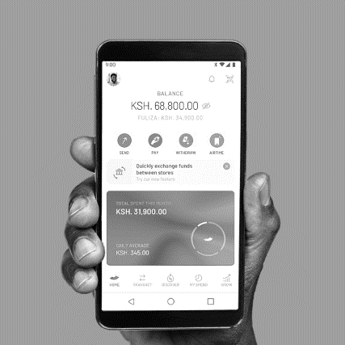
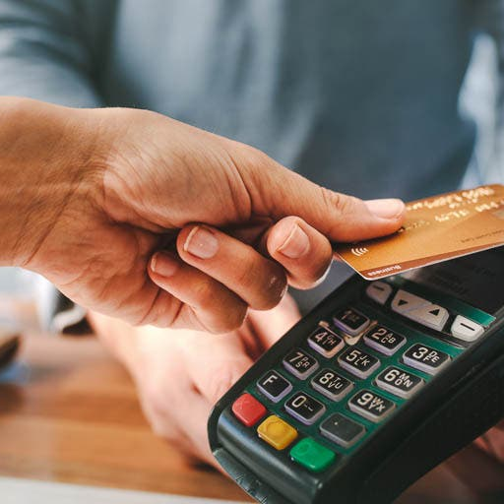
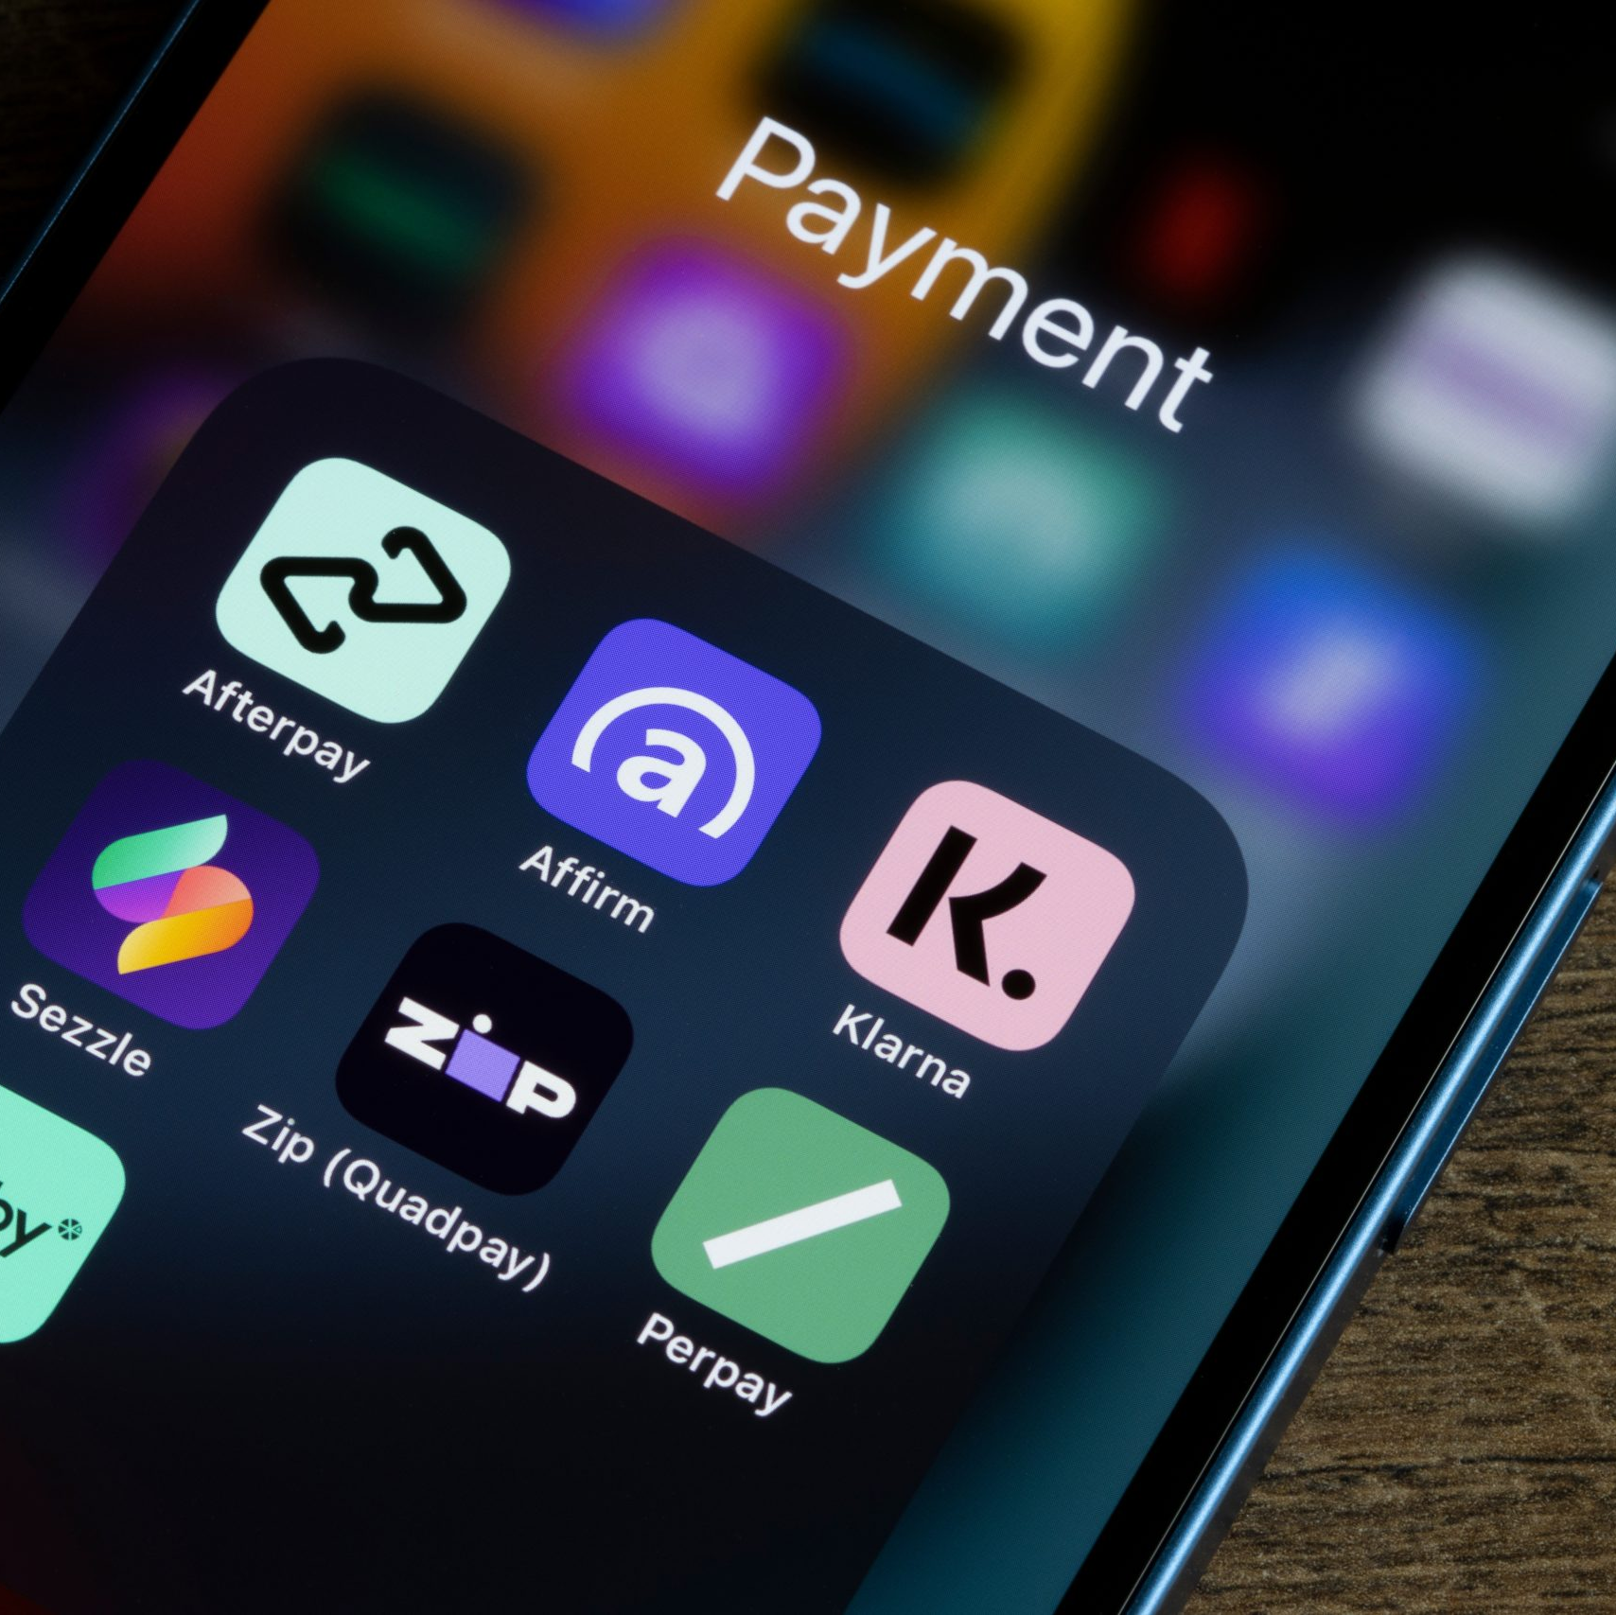
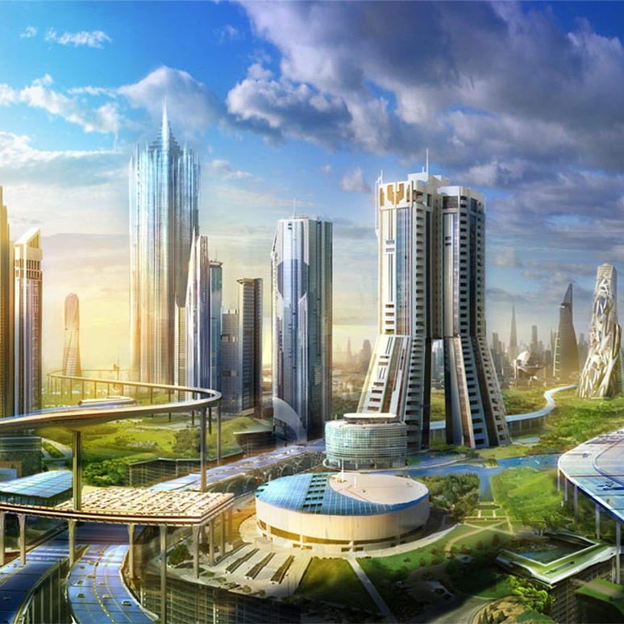
Globally the most recent and prevalent digital payments trends
Mobile Commerce: The trend towards convenience, accessibility and personalisation has made mobile commerce an attractive proposition for businesses and consumers
Digital payments have been driven by the recent pandemic and technological advancements that enhance customer experience, security and financial inclusion
Some of the fastest growth in digital payments occurred in Africa and Southeast Asia, where low banking penetration gives payments providers opportunities to capture untapped potential and reach underserved populations
Mobile P2P: M-Pesa Kenya and Vodafone M-PAiSA in Fiji are two P2P technologies that have enabled underbanked residents to send money conveniently
Contactless: Consumers enjoy a faster checkout experience, greater convenience, and robust security features for their transactions
BNPL: Buy Now Pay Later has thrived because it combines the flexibility of credit with short repayment terms, app-based shopping, and a simple user experience
SME Bundling: SMEs require to access high performance in a simple and secure way at a low price, early stage and growth-minded SMEs have a higher affinity to pick up a bundled solution
Smart Cities: Tolling payment apps, mobile ticketing in buses and street parking senses are examples of initiatives facilitating the shift towards smart cities
©2023 Mastercard. Proprietary and confidential
7
7
Notes:
Speaker: James
Digital payments has been expanding across the globe, this was accelerated by the recent pandemic where we saw permanent changes to the way consumers spend online and in-stores, this challenged the way merchants accepted payments and banks/fintechs had to adapt quickly to these changes.
During this time there were significant technological advancements that ultimately enhanced customer experiences that allowed them to make quicker and safer payments.
Some of the fastest growth in digital payments occurred in Africa and Southeast Asia, where low banking penetration gave payments providers opportunities to capture untapped potential and reach underserved populations.
The Mastercard team spent a lot of time researching developing and developed markets to see globally what were the most recent and prevalent trends and have summarised them here.
I’ll go through a few examples:
We know consumers are always looking for more convenience, spending and shopping through the phone is just so easy and personalised which allows an overall quicker and targeted customer journey
M-Paisa is widely used here in Fiji and a similar product exist in Kenya, which has allowed more underbanked locals to use digital payments
Contactless became important during COVID as it was just so much easier to spend and pay without touching any cards or terminals
Finally, we saw smart cities initiatives shifting entire economies to digital and making day to day life easier for all, such as toll payment apps and card payments for buses and trains

Slide 8
Payment Innovation in The Pacific
SME inclusion needs to be addressed
Sell unique and amazing products to the world!
Merchants want omni-channel capabilities

Slide 9
Tap on Phone
Uses the merchant’s own phone
It’s an app
Removes the need for a terminal and associated costs
Able to transact with customers who don’t have local currency
Creates a digital footprint for the merchant
Applications for ground transport, water transport, markets, gas deliveries………

Slide 10
eCommerce in the Pacific
Several IPGs currently available from banks
The majority are 3DS enabled
There are still barriers to merchants having access
The main barrier to inclusion is the misperception of risk

